Slide 1
Houston Housing

Slide 2
Property Value
Graph
Data sources/methodology
Limitations of dataset
Assumptions
Insights/trends

Slide 3
Crime trends

Slide 4
Flood trends

Slide 5
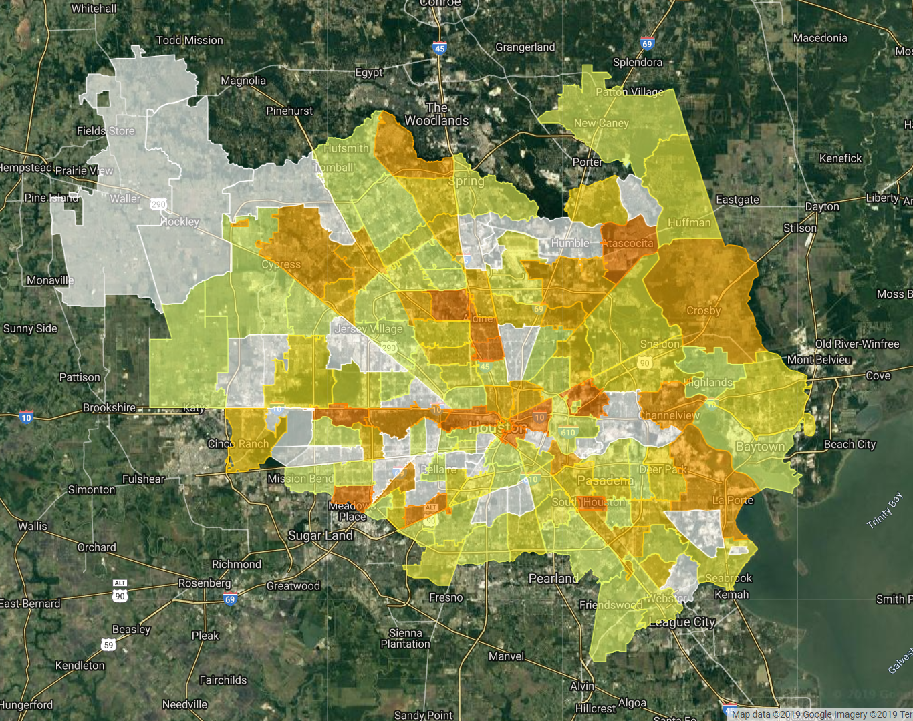
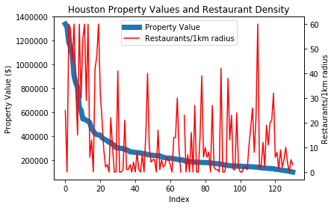
Restaurant Density
Correlation Coefficient: 0.47
weak positive linear relationship between property value and restaurant density
Highest restaurant density in central Houston and in some periphery

Slide 6
Final Insights

